Slide 1
Nde tiubo jai ganiu nagu Lamchap din ra lo
Dr. Rick Griffith, Singapore Bible College
BibleStudyDownloads.org

Slide 2
Chalad Padon thiu khang bo
vii
Pisikhairaibo (1 min.)
Nang gu lamchap (2-3 min.)
Maitu hiambo ladkeng (2 min.)
Chamlen ganiu Tacham (15 min.)
Chara cham ganiu Tacham (15 min.)
Notes:
Same slide for presentation 01.54 and 02.07 so translators may copy from one to the other

Slide 3
Nde leng nagu Lamchap din madu ralo?
16
. Nang nalam gara chiula je din lubui-e
Nang niu kamsibo-e
Nang niu silubo se din khaira leng wibo wan-e
Mainiu nang racham nking ni bo-e
Tingwang lam ga sisan lura natu nkha khai
Tingwang niu tien khaibo ngou ra natu nkha khai
Kawicham dinron leng pawan kawi
Maitu nkha khai jiu natu majang chaka
Mainiu naracham tu kam mou ngam lak ge
Notes:
Same slide for presentation 01.49 and 02.03 so translators may copy from one to the other except that 02.03 expands the 01.49 slide

Slide 4
Lamchap dinpatbo gu pasou
16
Lungli-Wanglubo sai:
Nang gu makum
Masan jiu kalipatmibo
Mating matad silo!
Lungliwangbo:
Tienrang dung pisikhailo
Nang niu malumbo
Mating matad silo!
Lungli-Makhabo ting:
Nang gu makum
Nangam kam
Mating matad silo!
Tacham gu
pakeng se kalimak
tajut jiu din bo!
Notes:
Same slide for presentation 01.50 and 02.04 so translators may copy from one to the other

Slide 5
Agu Lamchap
19
Lungli-Wang lubo sai:
Agi-manaibo
Katah-kanang habo
Maitu lungsa sibo
Lungliwangbo:
Chabonmai aruangbo
Jesu hai Tingwang kalen ye
“ Eh ‘ patoung dou tamine'"
Lungli-Makhabo ting:
Kawibo ngamkam
“Rutmakbo"
Chalung siambo
Khai nsam khai
katah-kanangbo keng se din tajut lo!

Slide 6
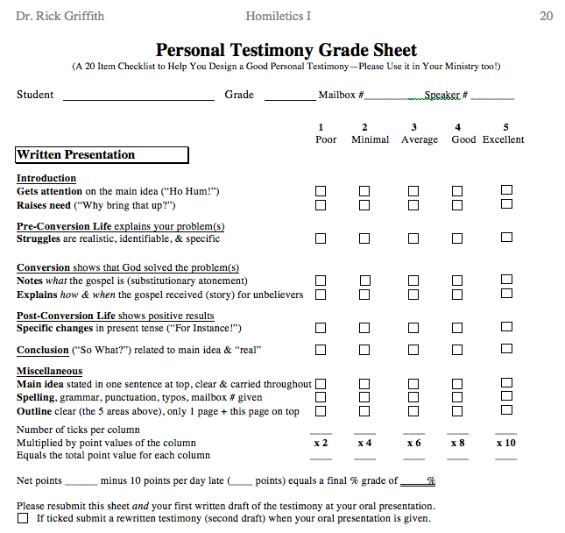
Testimony Grade Sheet
20
Pisikhairaibo
Lungli-Makha bo ting
Lungliwangbo
Lungli-Wanglubo sai
Kaloi bo lad bam
Tap-tapbo cham dung

Slide 7
Black

Slide 8
Kawicham paoron (Kawicham paoron bo pathak pajai) link at BibleStudyDownloads.org
Paman thiu mak jiu haise ngou lu ne!
Notes:
Preaching (pr)
Homiletics

